Slide 1
Lesson 1 - What is Data Science
Mack 2021

Slide 2


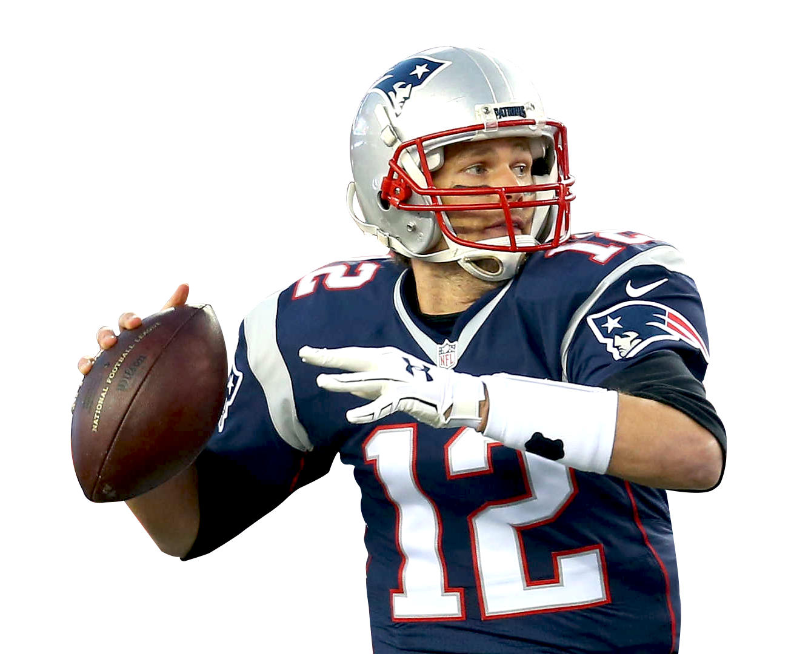
G.O.A.T
Who is the greatest athlete of all time?
Notes:
There have been many debates on who stands as the greatest of all time in their field. How do you answer questions such as “Who is the greatest athlete of all time?”

Slide 3


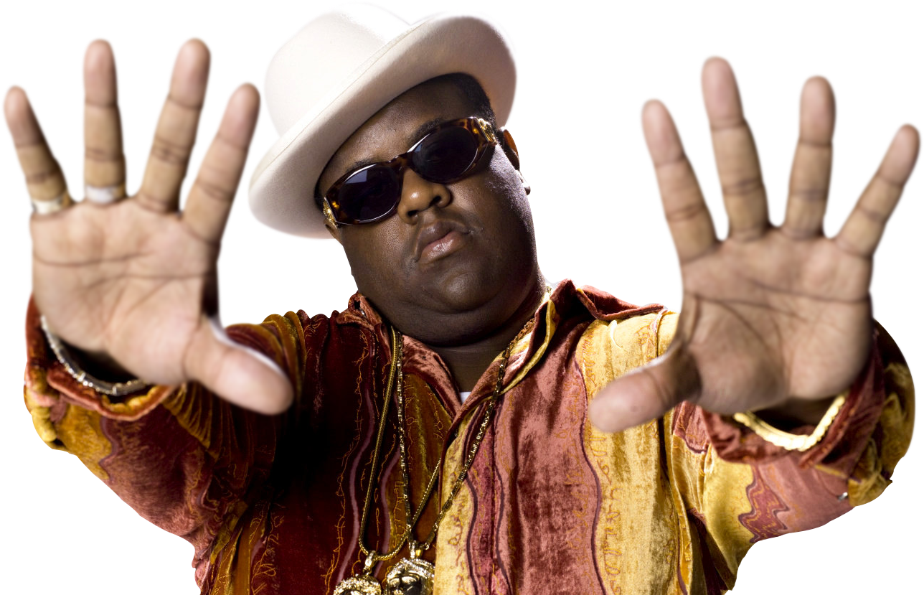

G.O.A.T
Who is the greatest rap artist of all time?
Notes:
Who is the greatest rap artist?

Slide 4



G.O.A.T
Which is the best comedy series of all time?
Notes:
How about the best comedy series of all time? Debates like this can easily get heated because they are full of differing opinions and are very subjective. Is there a way to actually determine the greatest athlete, rapper, or comedy series? How could you make a compelling argument? One that no one could disagree with? Is it even possible to do this?

Slide 5



G.O.A.T
What’s the best way to study for a math test?
What do 9th graders prefer to eat for lunch?
Do older people have more pets?
Notes:
Let’s dial it back a bit to questions that may not lead to such a heated discussion. There still might be different outlooks and opinion on the subjects at hand here but with less variables to consider. How could you go about figuring out the best way to study for a math test? Or which lunch item 9th graders prefer best? Can we find out if people who are older have more pets than those younger than them? Well, we definitely can using data science.

Slide 6

Data Science
Data science is the process of learning about the world using data and computation.
Exploring data sets
Using statistics
Creating data visualizations
Identifying patterns in data
Making predictions
Notes:
The process of learning from data is called Data Science. You can learn from data concerning 9th graders lunch preferences or the number of cats that older people own. All industries can learn something from data. Scientists, businesses, politicians, sports analysts, and hundreds of other different fields use data science to ask and answer questions about data. Some of the techniques used to learn about the world from data are exploring data sets, using statistics and data visualizations to identify patterns and make predictions. Ultimately data science is used to explore a data set or sample of data and can be used make predictions and draw reliable conclusions about the world.

Slide 7
Data Science
Career Points: 32,292
Grand Slam Wins: 23
Touchdown Passes: 661
Notes:
Now, just because data is involved doesn’t mean that the predictions or conclusions are irrefutable. You’ll learn during this course that opinions, or bias, can still live in how data is collected or how a data set is analyzed. For instance, how do we compare these athletes when they have such different achievements?

Slide 8
Statistical Questions
Statistical questions are questions that could have a variety of different answers.
How old am I?
How old are the students in my school?
Notes:
A main idea that is very important in learning about data science is knowing which questions to ask. A statistical question will have a variety of different answers. This typically results in data that you can collect and explore. A statistical question will also involve looking at more than just one piece of data. The question, “How old am I?” is not a statistical question because it can easily be answered by just accessing one value. There is only one answer. Now, the question, “How old are the students in my school?” qualifies as a statistical question because you need the dataset AND you can expect that there will be a variety of ages in the school.

Slide 9
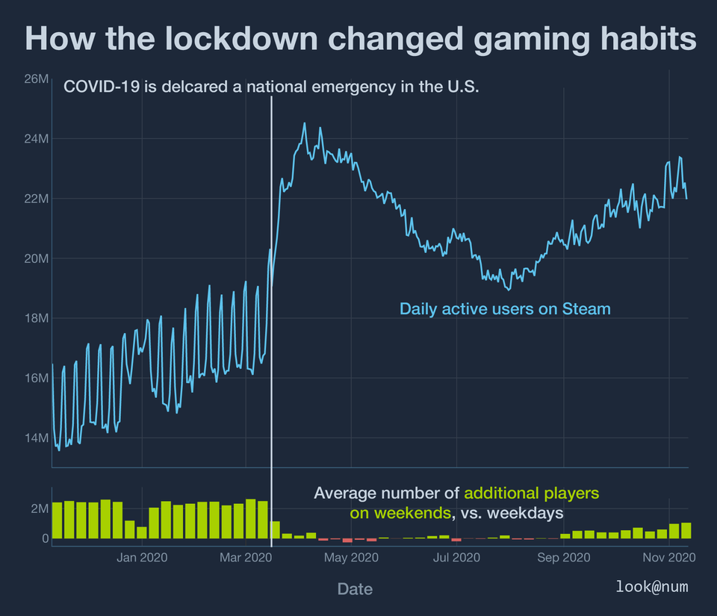
Statistical Questions
Source: https://www.reddit.com/user/lookatnum/
Notes:
Some good statistical questions could be “How has the lockdown changed gaming habits?”

Slide 10
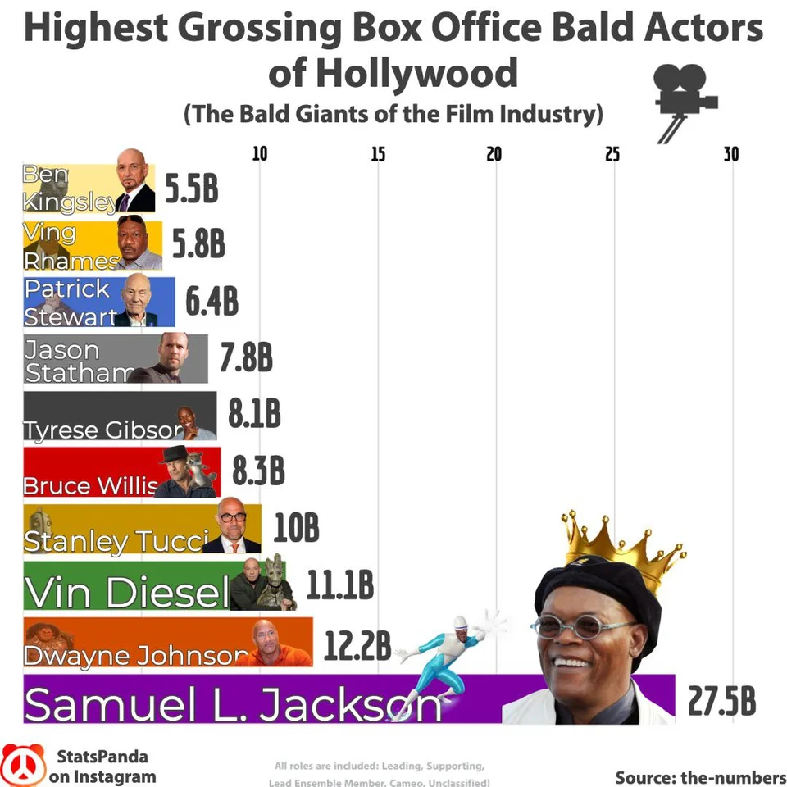
Statistical Questions
Source: https://www.reddit.com/user/Dremarious/
Notes:
Or “Which bald actor stars in the films that make the most money?”

Slide 11
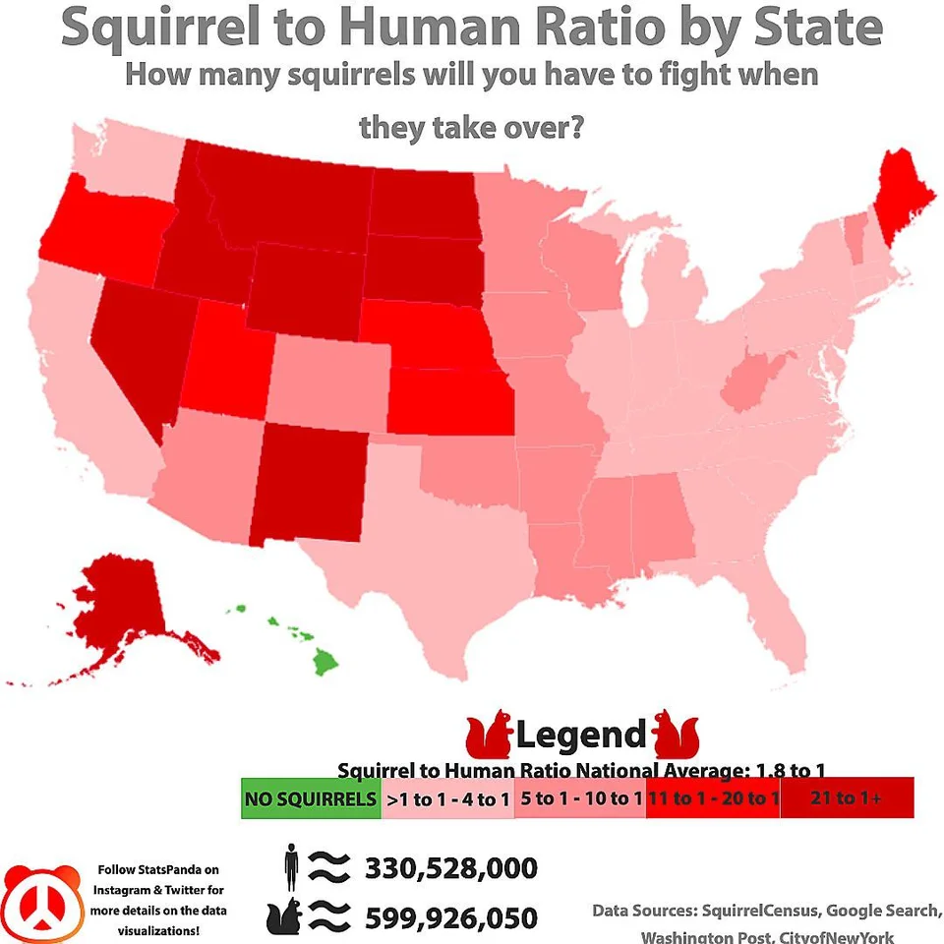
Statistical Questions
Source: https://www.reddit.com/user/Dremarious/
Notes:
Or even something as silly as “How many squirrels will you have to fight when they take over?”

Slide 12
Types of Questions
Lookup questions : Can be answered simply by looking up a single value in a dataset. These do not qualify as statistical questions.
Compute questions: Can be answered by computing an answer using more than one value found in the dataset.
Relate questions : Require finding a possible relationship between more than one value.
Can’t answer : Can’t be answered based on the available data.
Notes:
It’s good to know the different types of questions that can be asked as well. Lookup questions are questions that can easily be looked up by simply searching for the right value in the dataset. Something like “How many miles did you run on June 5th?” would be a look up question. It’s important to know that this is NOT a statistical question since you would only need to access one value to find the answer. A compute question is one that can be answered by using more than one value, like finding the average test score of the whole class. Relate questions are the most helpful and important types of questions in data science. These require examining and comparing values to see if there is a pattern or a relationship between them. And then there are also questions that you just can’t answer based on the data given. For these, you would need to possible do more research or find more data.

Slide 13
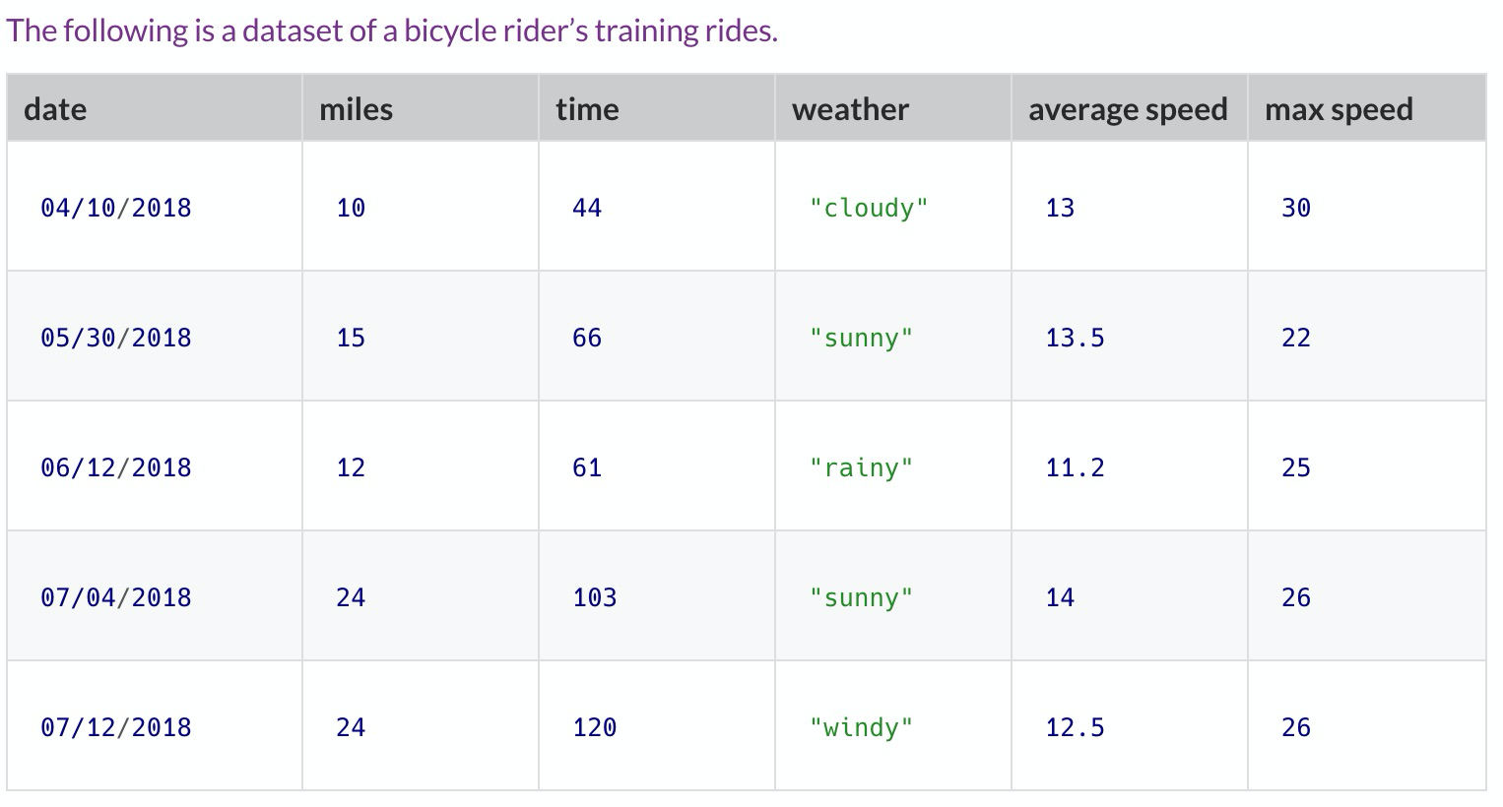

Types of Questions
Source: What Questions Can You Answer?, www.bootstrapworld.org/materials/fall2020/en-us/courses/data-science/lessons/ds-intro/pages/what-can-you-answer.html.
Notes:
Let’s take a look at this dataset that shows a bicycle rider’s training rides. Pause the video if you need to, to explore and notice what information is given in this table. Can you formulate a look up question, a compute question and a relate question based on the data?
A lookup question might be as simple as “How many miles did they ride on June 12th?” This would not qualify as a statistical question as you can easily just search the dataset for the answer and fin it.. right here.
A compute question could be “What is the cyclist’s average speed across all rides?” We would use this column to figure out this statistic.
A relate question could be “Does this cyclist ride slower when it is rainy?” It might be interesting to see if there was a relationship between the weather and the speed of the rider.
There are also many questions that cannot be answered such as “Does the amount of calories consumed have an affect on the rider’s speed?” We would need more data to answer this question.

Slide 14
Lesson Vocabulary
Term | Definition
data science | The process of learning about the world using data and computation.
statistical question | A question that could have a variety of different answers.

Slide 15
Which of the following is NOT a statistical question?
Notes:
🍐 This is a Pear Deck Multiple Choice Slide. Your current options are: A: How many jelly beans fit in a typical mason jar?, B: Which color jelly bean appears the most in a bag of jelly beans?, C: How many blue jelly beans are in your mason jar?, D: Who was closest in guessing how many jelly beans are in your mason jar?,
🍐 To edit the type of question or choices, go back to the "Ask Students a Question" in the Pear Deck sidebar.

Slide 16
True or False: Conclusions found using data are indisputable.
Notes:
🍐 This is a Pear Deck Multiple Choice Slide. Your current options are: A: true, B: false,
🍐 To edit the type of question or choices, go back to the "Ask Students a Question" in the Pear Deck sidebar.

Slide 17
Which question requires finding a relationship or pattern between more than one value?
Notes:
🍐 This is a Pear Deck Multiple Choice Slide. Your current options are: A: What did you score on the last math test?, B: What is the average grade of a student in the 9th-grade social studies class?, C: Which Spanish teacher has the greatest effect on the overall student average?,
🍐 To edit the type of question or choices, go back to the "Ask Students a Question" in the Pear Deck sidebar.

Slide 18


